Slide 1
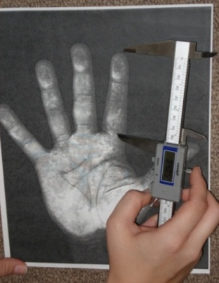
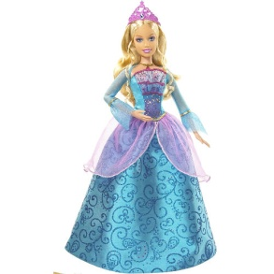
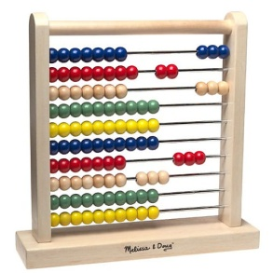
Adult Women With Shorter Digit Ratios Rate Boy-Typed Toys More Favorably
Dennis Goff, Shi Hua, & Jillian Barlowe
Randolph College
If preference for gender typed toys is related to prenatal exposure to testosterone then digit ratio (2D:4D) and asymmetry in right and left ratios should correlate with ratings of gender typed toys. Significant correlations between adult women’s digit ratios and ratings preferences for boy-typed toys support this hypothesis.
Discussion
This is the first study to demonstrate significant correlations between digit ratio and ratings for boy-typed toys in adult women. It replicates Crippen’s (2008) results for children and extends results from a study that used eye-tracking to show a similar association in adults (Alexander 2006). The results extend other research from a pathological population, girls who have CAH (Berenbaum, 1999; Hines & Kaufman, 1994) and experimental work with non-human primates (Wallen, 1996). The current results suggest that normally fluctuating prenatal testosterone levels are related to adult female toy ratings and that digit-ratio in the right hand is the more sensitive indicator of that effect.
The ratio of lengths in the second and fourth digits (2D:4D) has been established as an indicator of prenatal exposure to testosterone (Knickmeyer & Baron-Cohen, 2006; Lutchmaya, Baron-Cohen, Raggatt, Knickmeyer, & Manning, 2004). In this sexually dimorphic trait, lower ratios are associated with higher prenatal exposures to the androgen. While somewhat controversial, this indicator has been associated with gender preference in adult populations (McFadden, Loehlin, Breedlove, Lippa, Manning, & Rahman, 2005). Similarly, attempts to correlate digit ratio with gender identity in adult samples have yielded mixed results (Beech & Mackintosh, 2005; Csathó, et al., 2003). Others have suggested that asymmetry in digit-ratios could serve as a more sensitive measure of prenatal testosterone effects (Manning, Bundred, Newton, & Flanagan, 2003).
Recently Crippen (2008) used toy preference as a preliminary indicator of gender identity among preschool-aged children. She found right hand digit ratio was correlated with toy preference among girls only. The current research replicated that study with an adult sample to test the possibility that this more subtle indicator of gender identity could yield correlations with digit ratio in adults.
Results
A first set of analyses tested for sex differences in both the predictor and criterion variables. All three of the physiological measures differed in the predicted direction; however, only the digit-ratio in the right hand yielded a significant sex difference (Wilkes λ = .895, F(2, 63) = 3.65, p=.032, DR_{right} : F(1,64) = 7.412, p = .008, η² = .105). All of the measures for ratings of gender-typed toys yielded significant sex differences in the expected directions (Wilkes λ = .287, F(9, 56) = 15.486, p<.001, all individual p’s < .001, η² ‘s >.330).
Significant correlations between digit ratio in the right hands were found for ratings of the boys’ toys only, (for PLAY r = -.329, p=.029, OWN r = -.405, p = .006, and FAV r = -.360, p= .016). The pattern of significant correlations between asymmetry and ratings of the boys’ toys in part paralleled the right hand digit ratios (PLAY, r = .181, ns, OWN r = .357, p = .010, FAV r = .328, p = .020). There were no significant correlations between digit ratio in the left hand and any of the toy ratings.
References
Alexander, G. (2006). Associations among gender-linked toy preferences, spatial ability, and digit ratio: Evidence from eye-tracking analysis. Archives of Sexual Behavior, 35(6), 699-709.
Beech, J. R., & Mackintosh, I. C. (2005). Do differences in sex hormones affect handwriting style? Evidence from digit ratio and sex role identity as determinants of the sex of handwriting. Personality and Individual Differences, 39, 459-468.
Berenbaum, S. A. (1999). Effects of early androgens on sex-typed activities and interests in adolescents with Congenital Adrenal Hyperplasia. Hormones and Behavior, 35, 102-110.
Crippen, A. (April, 2008). Digit Ratio as a Predictor of Toy Preference and Mental Rotation Ability in Preschool Children Virginia Psychological Association. Charlottesville ,VA.
Csathó, Á., Osváth, A., Bicsák, É., Karádi, K., Manning, J., & Kállai, J. (2003). Sex role identity related to the ratio of second to fourth digit length in women. Biological Psychology, 62(2), 147-156.
Hampson, E., Ellis, C., & Tenk, C. (2008). On the relation between 2D:4D and sex-dimorphic personality traits. Archives of Sexual Behavior, 37(1), 133-144.
Hines, M., & Kaufman, F. R. (1994). Androgen and the development of human sex-typical behavior: Rough-and-tumble play and sex of preferred playmates in children with Congenital Adrenal Hyperplasia (CAH). Child Development, 65(4), 1042-1053.
Knickmeyer, R., & Baron-Cohen, S. (2006). Fetal testosterone and sex differences. Early Human Development, 82(12), 755-760.
Lutchmaya, S., Baron-Cohen, S., Raggatt, P., Knickmeyer, R., & Manning, J. (2004). 2nd to 4th digit ratios, fetal testosterone and estradiol. Early Human Development, 77(1), 23-28.
Manning, J. T., Bundred, P. E., Newton, D. J. & Flanagan, B. F. (2003). The second to fourth digit ratio and variation in the androgen receptor gene. Evolution and Human Behavior, 24, 399-405.
McFadden, D., Loehlin, J., Breedlove, S., Lippa, R., Manning, J., & Rahman, Q. (2005). A Reanalysis of Five Studies on Sexual Orientation and the Relative Length of the 2nd and 4th Fingers (the 2D:4D Ratio). Archives of Sexual Behavior, 34(3), 341-356.
Wallen, K. (1996). Nature needs nurture: The interaction of hormonal and social influences on the development of behavioral sex differences in rhesus monkeys. Hormones and Behavior, 30(4), 364-378.
Method
Measurements of the length of the ring and index fingers on each hand were made to .01 cm from photocopies using a digital Vernier caliper. Inter-rater reliabilities were over .95 for all digits. Digit ratios were calculated as the length of the index finger (2D) divided by the length of the ring finger (4D). Asymmetry was calculated as the left digit ratio minus the right. Smaller digit ratios and larger asymmetries are associated with higher prenatal testosterone exposures.
Fifty-six adult women and 15 adult men were asked to imagine that they were seven years old and then asked to rate a series of 15 black and white photographs of children’s toys. They indicated on a 5-point scale how much they would like to play with the toy (PLAY) or own the toy (OWN). They also rated how likely it was to be a their favorite (FAV). Based on previous ratings five toys represented each of three sex-typed classes, for example a doll represented “girls’ typical toys” and a tow-truck represented “boys’ typical toys”. Ratings were averaged for each category; high scores indicated more favorable ratings.
 | Boy’s toys |  |  | Girl’s toys |  |  | Neutral toys
 | Play | Own | Favorite | Play | Own | Favorite | Play | Own | Favorite
DR Left | -.045 | .002 | .036 | -.267 | -.223 | -.189 | -.046 | -.102 | .060
DR Right | -.329 | -.405 | -.360 | .051 | .011 | .006 | .113 | .045 | -.090
Asymmetry | .181 | .357 | .328 | -.200 | -.110 | -.097 | -.200 | -.161 | .059
Presented: APS, Boston MA, May 2010 Contact: dgoff@randolphcollege.edu

